Slide 1


Department of ECE
Embedded PROTOTYPE
PROJECT TITLE
Design and Implementation of Automated Medical Dispenser using ESP32
Presented by
Devineni.Prem Nag
D.Shanmukha Venkata Sai
M.Hemanth Kumar
SK.Sajeeth Shareef
Guided by
Dr.A V.Prabhu
Associate Professor
Dept of ECE

Slide 2



INTRODUCTION
Medication adherence is essential for effective treatment and patient health.
Many patients, especially elderly people, forget to take medicines on time.
Incorrect dosage intake can lead to serious health complications.
Smart healthcare solutions using IoT help automate medication management
An automated medical dispenser provides scheduled medicine delivery with reminders.
ESP32 microcontroller enables real-time monitoring and IoT connectivity.

Slide 3
PROJECT DESCRIPTION
Uses ESP32 as the main control unit.
RTC module ensures accurate real-time medication timing.
Designed to automatically dispense medicines at scheduled times.
Motor mechanism rotates pill container for dispensing .
Buzzer alerts patient when medicine is dispensed.
LCD/OLED display shows time and dosage information.
WiFi-enabled IoT system sends notifications to caregivers.
Reduces medication errors and improves patient adherence.
Suitable for elderly care, home healthcare, and hospitals.

Slide 4
Objectives
Design automated medicine dispensing system.
Ensure accurate medication timing.
Provide alerts and reminders.
Enable remote monitoring using IoT.
Reduce medication errors.
Improve patient adherence and safety.
Develop a user-friendly interface for schedule setting
Create a cost-effective and portable healthcare solution
Support caregivers with real-time notifications

Slide 5
Circuit Diagram
ESP32
RTC
Module
5V POWER
SUPPLY
SERVO
MOTOR

Slide 6
HARDWARE & SOFTWARE REQUIREMENTS
Software Requirements:
Arduino IDE / ESP-IDF
Embedded C / Arduino Programming
ESP32 Board Support Package
RTC Library (RTClib)
Servo / Motor Control Library
ESP32 WiFi Library
IoT Platform (Blynk / Firebase / ThingSpeak)
Serial Monitor (for debugging)

Slide 7
HARDWARE & SOFTWARE REQUIREMENTS
Hardware Requirements:
ESP32 Microcontroller
RTC Module (DS3231)
Servo Motor / DC Motor
Motor Driver (L298N / ULN2003)
LCD / OLED Display
Buzzer
Push Buttons
Pill Container
Connecting Wires
Breadboard / PCB
Power Supply (5V / 12V Adapter)

Slide 8
Flowchart
Start System
Initialize RTC & Servo
Read Current Time from RTC
Current Time =
Scheduled Time ?
Trigger Motor Pin High (Dispense)
Wait 1000ms
Return Motor Pin Low (Reset)
Wait 60 seconds

Slide 9
Advantages
Ensures accurate and timely medicine dispensing
Reduces chances of missed doses
Minimizes human errors in medication intake
Provides automatic alerts and reminders
Enables remote monitoring through IoT
Improves patient safety and adherence
Useful for elderly and chronically ill patients
Cost-effective and portable solution
Easy to operate and user-friendly

Slide 10
Applications
Elderly care and senior citizen homes
Home healthcare monitoring
Hospitals and clinics
Chronic disease management (diabetes, BP, heart patients)
Assisted living centers
Rehabilitation centers
Post-surgery patient care
Remote patient monitoring systems
Rural healthcare services
Smart healthcare IoT solutions

Slide 11
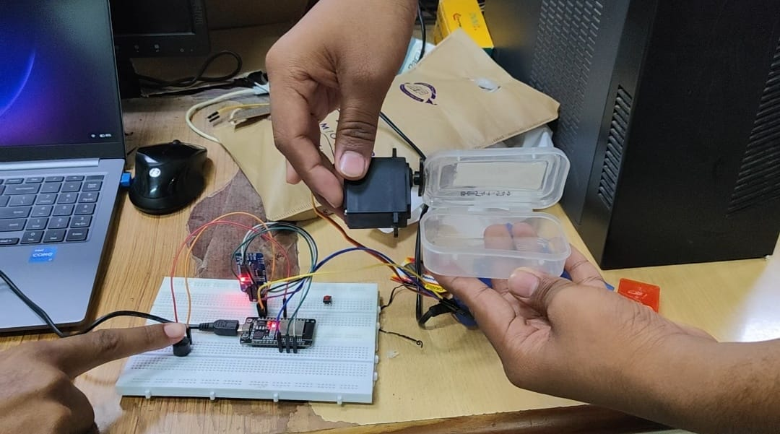
Results

Slide 12
Future Scope
Integration with AI for dosage analysis and patient behavior monitoring
Mobile app with prescription upload and tracking system
Cloud data storage for long-term medication history
Voice assistant integration (Alexa / Google Assistant)
Camera-based verification to confirm medicine intake
SMS, Email, and WhatsApp alert system
Biometric authentication (fingerprint / face recognition)
Automatic refill notification system
Battery backup with power failure alert
Integration with hospital management systems
Multi-user support for family medication tracking

Slide 13
Conclusion
The Automated Medical Dispenser using ESP32 provides a reliable solution for timely and accurate medicine dispensing
It reduces medication errors and improves patient adherence through automation.
The RTC ensures precise scheduling, while the alert system notifies patients effectively.
IoT connectivity enables remote monitoring by caregivers. Overall, the system offers a cost-effective and smart healthcare solution for modern medical needs.

Slide 14
PROJECT OUTCOMES
Successfully designed and implemented an automated medicine dispensing system Achieved accurate medication scheduling using RTC module.
Ensured reliable pill dispensing through motor mechanism.
Implemented alert system (buzzer and display) for patient notification.
Established IoT connectivity for remote monitoring and notifications.

Slide 15
TEAM MEMBERS DETAILS
MEMBER NAME AND ITS CONTRIBUTION
Devineni.Prem Nag
D.Shanmukha Venkata Sai
M.Hemanth Kumar
SK.Sajeeth Shareef

Slide 16
REFERENCES OF THE PROJECT
Reference Books:
Getting Started with ESP32 – Neil Kolban
Internet of Things: A Hands-On Approach – Arshdeep Bahga & Vijay Madisetti
Exploring Arduino – Jeremy Blum
Embedded Systems: Introduction to ARM Cortex-M Microcontrollers – Jonathan W. Valvano
Designing Embedded Systems with PIC Microcontrollers – Tim Wilmshurst
Sites and Web links:
Espressif Systems – https://www.espressif.com
Arduino – https://www.arduino.cc
IEEE Xplore – https://ieeexplore.ieee.org
Random Nerd Tutorials – https://randomnerdtutorials.com

Slide 17
THANK YOU
Embedded system application & Iot programming

